Slide 1
SPM course – May 2011
Linear Models – Contrasts
Jean-Baptiste Poline
Neurospin, I2BM, CEA
Saclay, France
Notes:
Among the various tools that SPM uses to anlyse brain images, I will concentrate on two aspects : the linear model that is fitted to the data and the test.
In particular, I wish to give you enough information such that you may be able to undezrstand some difficulties that may arise when using linear model.

Slide 2
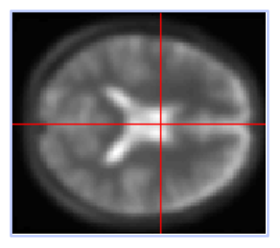

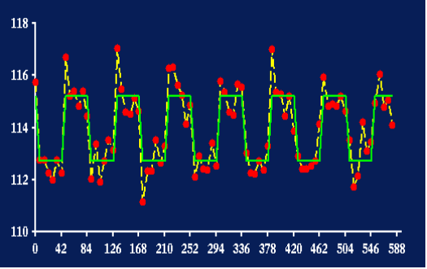
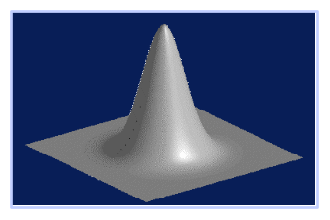
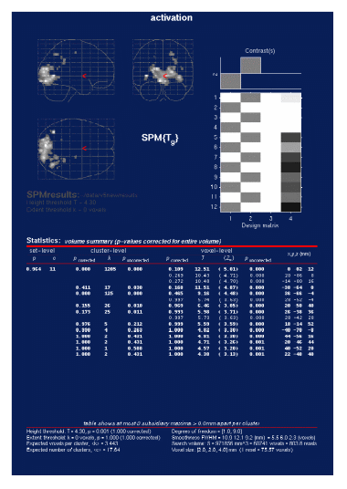
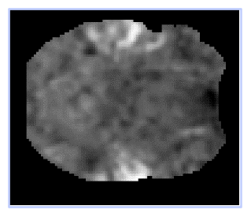
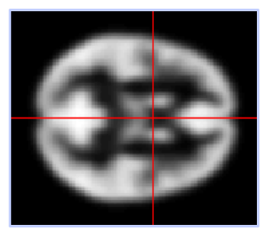
images
Design
matrix
Adjusted data
Your question:
a contrast
Spatial filter
realignment &
coregistration
General Linear Model
Linear fit
  statistical image
Random Field Theory
smoothing
normalisation
Statistical Map
Uncorrected p-values
Anatomical
Reference
Corrected p-values

Slide 3
Plan
REPEAT: model and fitting the data with a Linear Model
Make sure we understand the testing procedures : t- and F-tests
But what do we test exactly ?
Examples – almost real

Slide 4
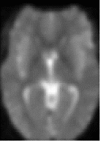
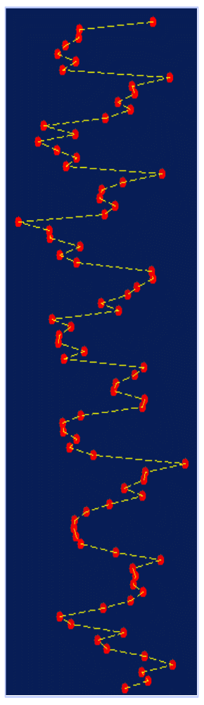

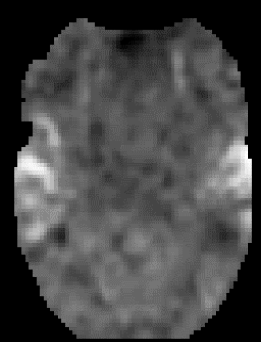
One voxel = One test (t, F, ...)
amplitude
General Linear Model
  fitting
  statistical image
time
Statistical image
(SPM)
Temporal series fMRI
voxel time course

Slide 5
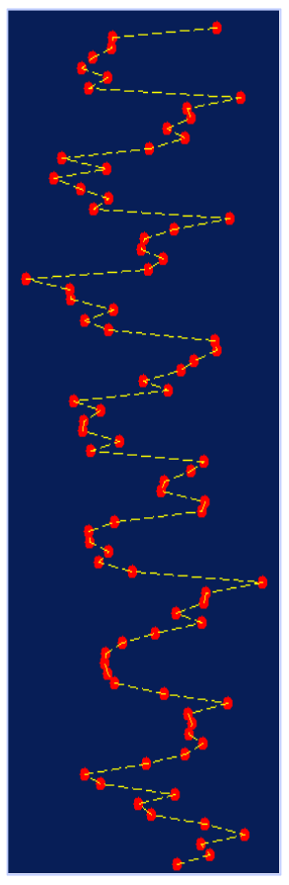
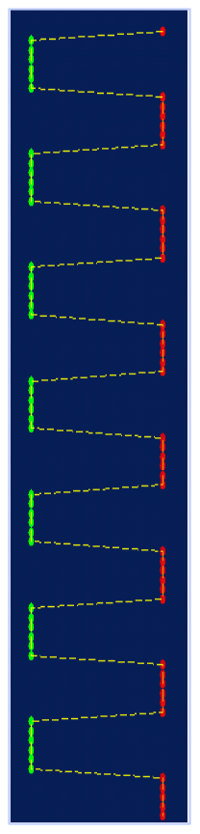

Regression example…
90 100 110
-10 0 10
90 100 110
-2 0 2
=
β₁
+
β₂
+
β₁ = 1
β₂ = 1
Fit the GLM
voxel time series
box-car reference function
Mean value

Slide 6
Regression example…
90 100 110
-2 0 2
0 1 2
-2 0 2
=
β₁
+
β₂
+
β₁ = 5
β₂ = 100
Fit the GLM
voxel time series
box-car reference function
Mean value

Slide 7




…revisited : matrix form
=
β₁
+
β₂
+
Y
=
β₁
×
f(t)
+
β₂
×
1
+
ε

Slide 8



Box car regression: design matrix…
data vector
(voxel time series)
parameters
error vector
design matrix
α
β₁
=
×
+
μ
β₂
Y
=
X
×
β
+
ε

Slide 9
Fact: model parameters depend on regressors scaling
Q: When do I care ?
A: ONLY when comparing manually entered regressors (say you would like to compare two scores)
careful when comparing two (or more) manually entered regressors!

Slide 10
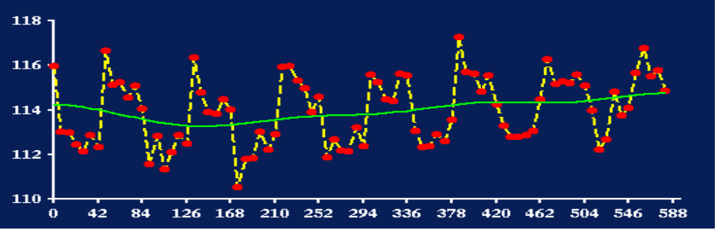
What if we believe that there are drifts?

Slide 11
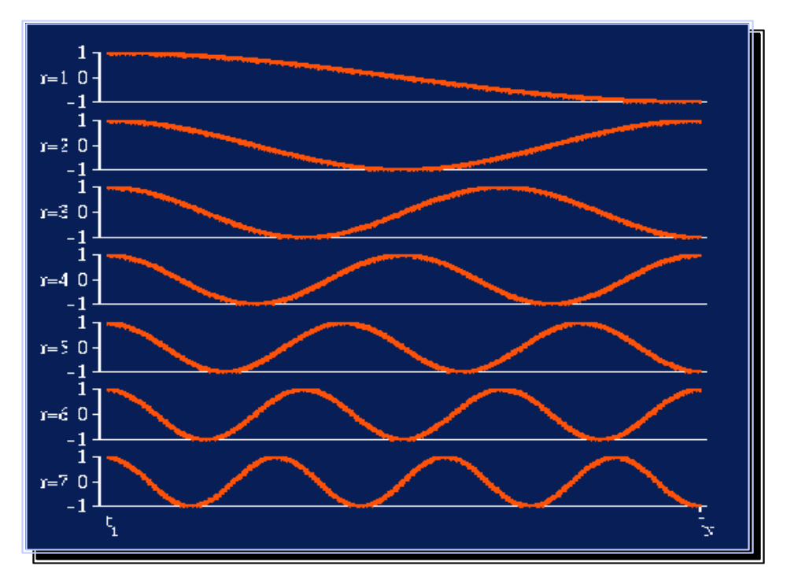
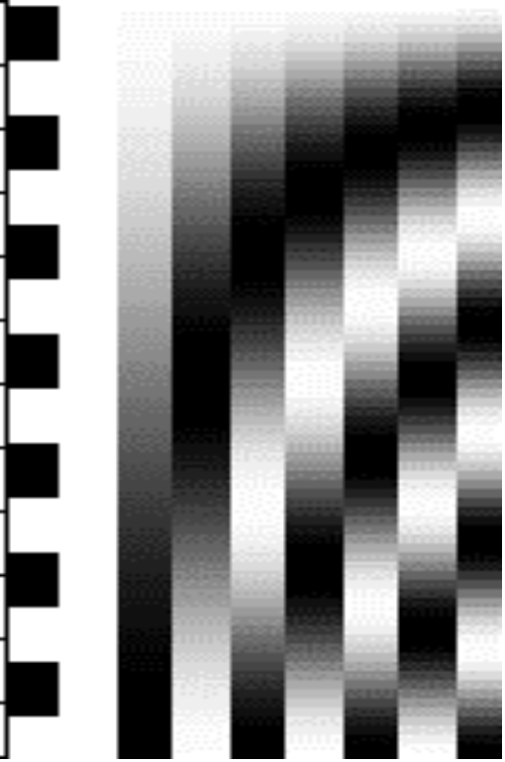
Add more reference functions / covariates ...
Discrete cosine transform basis functions

Slide 12
…design matrix
…
β₁
β₂
β₃
β₄
error vector
data vector
=
+
Y
=
X
×
β
+
ε

Slide 13
…design matrix
= the betas (here : 1 to 9)
parameters
error vector
data vector
design matrix
β₁
α
μ
β₃
β₄
β₅
β₆
β₇
β₈
β₉
β₂
=
+
Y
=
X
×
β
+
ε

Slide 14
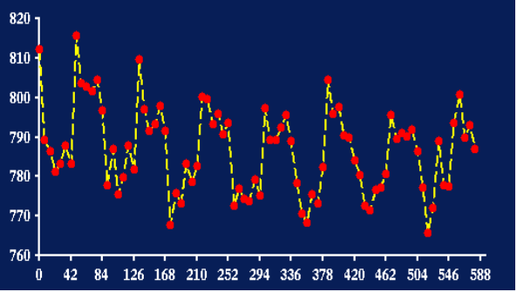

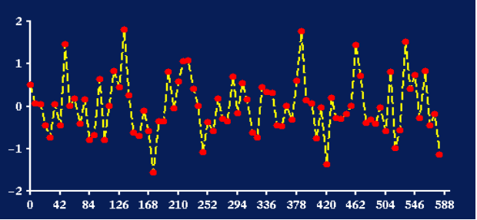
Fitting the model = finding some estimate of the betas
raw fMRI time series
adjusted for low Hz effects
Raw data
fitted signal
fitted low frequencies
fitted drift
residuals
How do we find the betas estimates? By minimizing the residual variance

Slide 15
Fitting the model = finding some estimate of the betas
β₁
β₂
β₅
β₆
β₇
...
=
+
Y = X β + ε
Y = X b + e
finding the betas = minimising the sum of square of the residuals
∥Y−X ∥² = Σ_{i} [ y_{i}−X _{i} ]²
^
when β are estimated: let’s call them b (or β)
when ε is estimated : let’s call it e
estimated SD of ε : let’s call it s

Slide 16
Take home ...
We put in our model regressors (or covariates) that represent how we think the signal is varying (of interest and of no interest alike)
  WHICH ONE TO INCLUDE ?
  What if we have too many? Too few?
Coefficients (= parameters) are estimated by minimizing the fluctuations, - variability – variance – of estimated noise – the residuals.

Slide 17
Plan
Make sure we all know about the estimation (fitting) part ....
Make sure we understand t and F tests
But what do we test exactly ?
An example – almost real

Slide 18
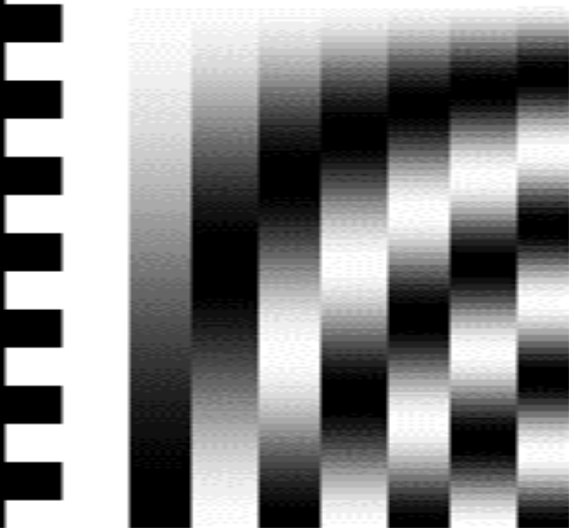
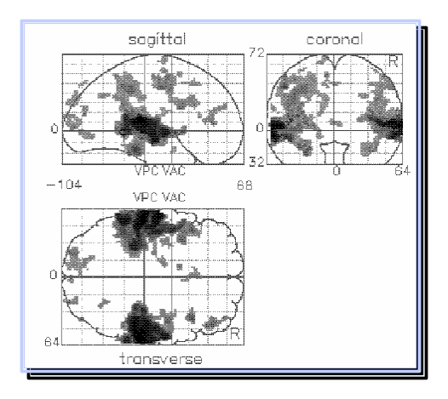
T test - one dimensional contrasts - SPM{t}
A contrast = a weighted sum of parameters: c´ × b
c’ = 1 0 0 0 0 0 0 0
b₁ > 0 ?
Compute 1xb₁ + 0xb₂ + 0xb₃ + 0xb₄ + 0xb₅ + . . .= c’b
c’ = [1 0 0 0 0 ….]
b₁ b₂ b₃ b₄ b₅ ....
divide by estimated standard deviation of b₁
contrast of
estimated
parameters
c’b
T =
T =
variance
estimate
s²c’(X’X)⁻c
SPM{t}

Slide 19
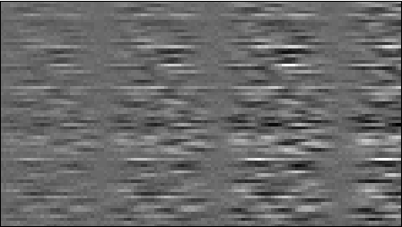
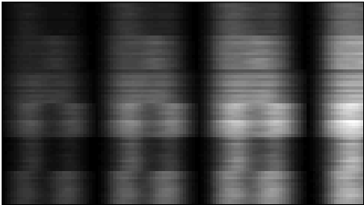
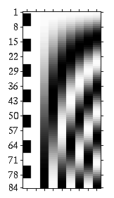


From one time series to an image
voxels
=
X
*
B
+
E
Y: data
beta??? images
scans
Var(E) = s²
spm_ResMS
c’b
c’ = 1 0 0 0 0 0 0 0
T =
=
s²c’(X’X)⁻c
spm_con??? images
spm_t??? images

Slide 20

F-test : a reduced model
H₀: True model is X₀
H₀: β₁ = 0
X₀
X₀
c’ = 1 0 0 0 0 0 0 0
X₁
F ~ ( S₀² - S² ) / S²
T values become F values. F = T²
Both “activation” and “deactivations” are tested. Voxel wise p-values are halved.
S²
S₀²
This (full) model ?
Or this one?

Slide 21

F-test : a reduced model or ...
Tests multiple linear hypotheses : Does X1 model anything ?
H₀: True (reduced) model is X₀
X₀
X₁
X₀
additional
variance
accounted for
by tested effects
S²
S₀²
F =
error
variance
estimate
F ~ ( S₀² - S² ) / S²
This (full) model ?
Or this one?

Slide 22
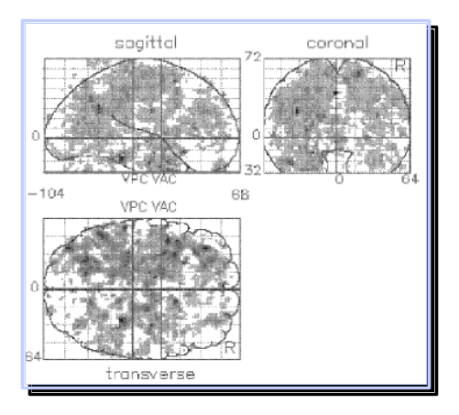
F-test : a reduced model or ... multi-dimensional contrasts ?
tests multiple linear hypotheses. Ex : does drift functions model anything?
H₀: True model is X₀
H₀: β₃₋₉ = (0 0 0 0 ...)
X₀
X₁
X₀
0 0 1 0 0 0 0 0
0 0 0 1 0 0 0 0
0 0 0 0 1 0 0 0
0 0 0 0 0 1 0 0
0 0 0 0 0 0 1 0
0 0 0 0 0 0 0 1
c’ =
This (full) model ?
Or this one?

Slide 23
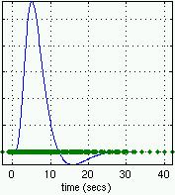
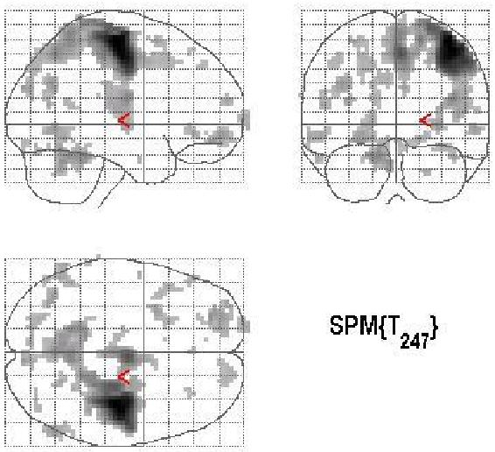

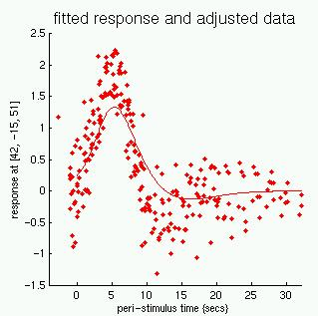

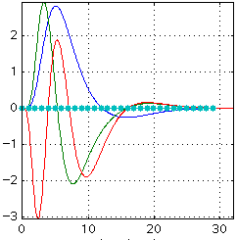
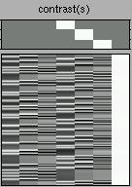
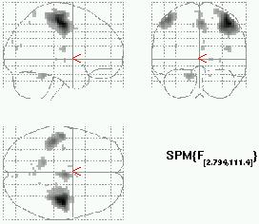
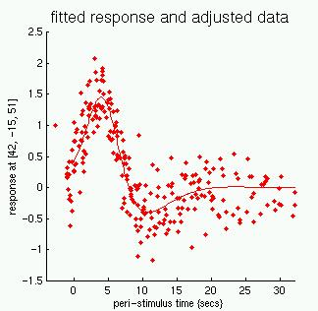
Convolution
model
Design and
contrast
SPM(t) or
SPM(F)
Fitted and
adjusted data

Slide 24
T and F test: take home ...
T tests are simple combinations of the betas; they are either positive or negative (b1 – b2 is different from b2 – b1)
F tests can be viewed as testing for the additional variance explained by a larger model wrt a simpler model, or
F tests is the square of one or several combinations of the betas
in testing “simple contrast” with an F test, for ex. b1 – b2, the result will be the same as testing b2 – b1. It will be exactly the square of the t-test, testing for both positive and negative effects.

Slide 25
Plan
Make sure we all know about the estimation (fitting) part ....
Make sure we understand t and F tests
But what do we test exactly ? Correlation between regressors
An example – almost real

Slide 26
« Additional variance » : Again
No correlation between green red and yellow

Slide 27
Testing for the green
correlated regressors, for example
green: subject age
yellow: subject score

Slide 28
Testing for the red
correlated contrasts

Slide 29
Testing for the green
Very correlated regressors ?
Dangerous !

Slide 30
Testing for the green and yellow
If significant ? Could be G or Y !

Slide 31
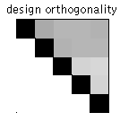
Testing for the green
Completely correlated regressors ?
Impossible to test ! (not estimable)

Slide 32
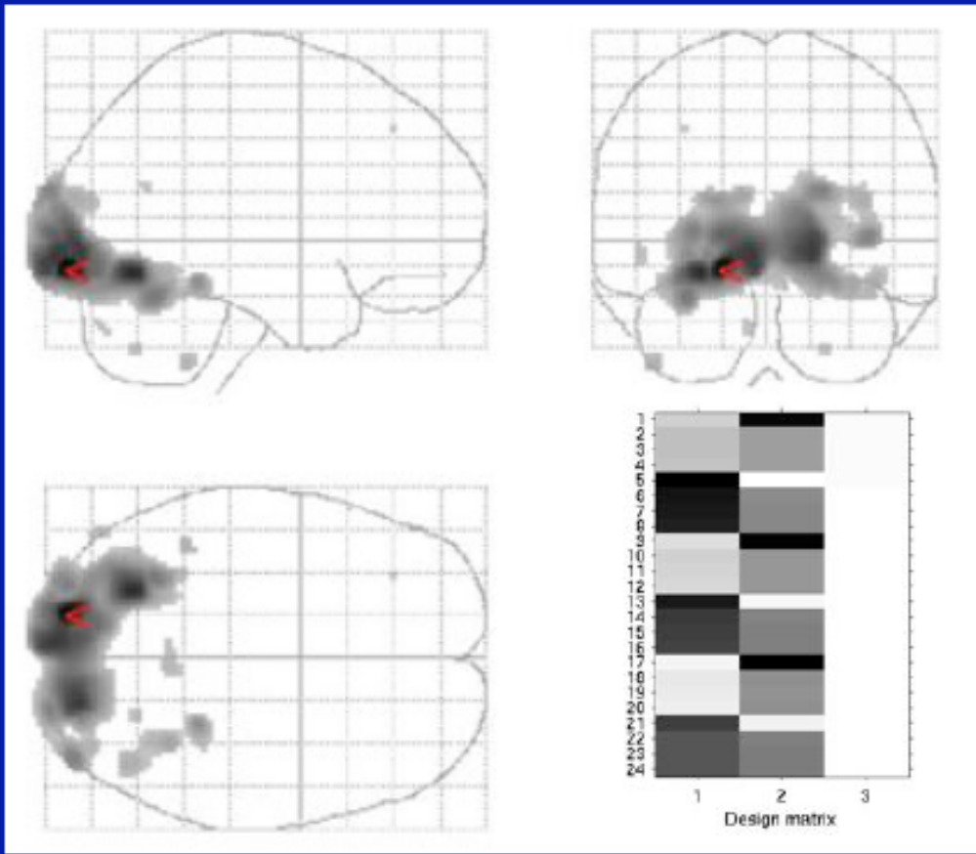
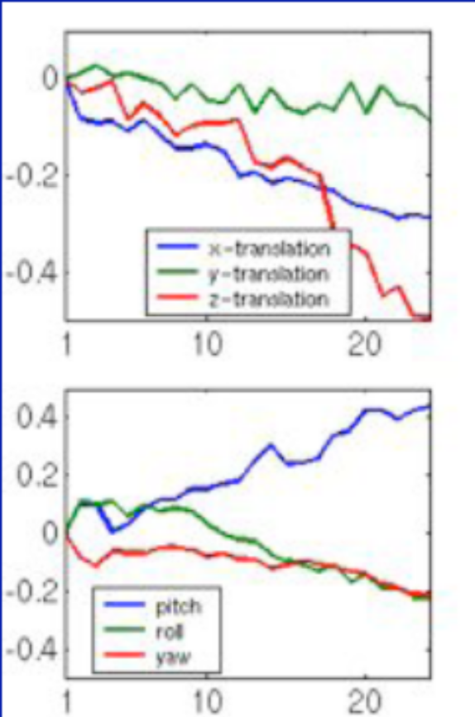
An example: real
Testing for first regressor: T max = 9.8

Slide 33
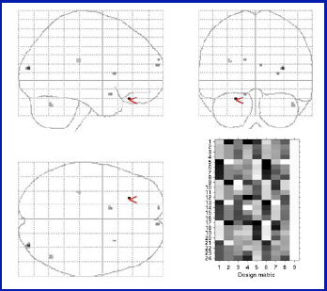
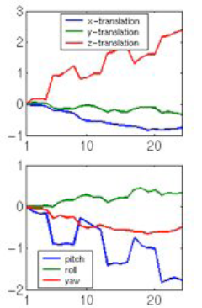
Including the movement parameters in the model
Testing for first regressor: activation is gone !
Right or Wrong?

Slide 34
Implicit or explicit (⊥) decorrelation (or orthogonalisation)
Y
e
Xb
C2
Space of X
C1
C2
C2⊥
Xb
L_{C1}⊥
L_{C2}
C1
This generalises when testing several regressors (F tests)
L_{C2} :
test of C2 in the
implicit ⊥ model
L_{C1}⊥ :
test of C1 in the
explicit ⊥ model
cf Andrade et al., NeuroImage, 1999

Slide 35
Correlation between regressors: take home ...
Do we care about correlation in the design ? Yes, always
Start with the experimental design : conditions should be as uncorrelated as possible
use F tests to test for the overall variance explained by several (correlated) regressors

Slide 36
Plan
Make sure we all know about the estimation (fitting) part ....
Make sure we understand t and F tests
But what do we test exactly ? Correlation between regressors
An example – almost real

Slide 37
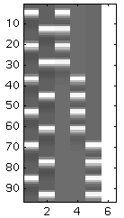
A real example (almost !)
Experimental Design
Design Matrix
Factorial design with 2 factors : modality and category
2 levels for modality (eg Visual/Auditory)
3 levels for category (eg 3 categories of words)
V A C₁ C₂ C₃
C1
V
C2
C3
C1
C2
A
C3

Slide 38
Asking ourselves some questions ...
V A C₁ C₂ C₃
Test C1 > C2 : c = [ 0 0 1 -1 0 0 ]
Test V > A : c = [ 1 -1 0 0 0 0 ]
[ 0 0 1 0 0 0 ]
Test C1,C2,C3 ? (F) c = [ 0 0 0 1 0 0 ]
[ 0 0 0 0 1 0 ]
Test the interaction MxC ?
Design Matrix not orthogonal
Many contrasts are non estimable
Interactions MxC are not modelled

Slide 39
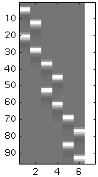
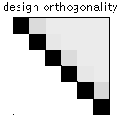
Modelling the interactions

Slide 40
Test C1 > C2 : c = [ 1 1 -1 -1 0 0 0]
C₁ C₁ C₂ C₂ C₃ C₃
Test V > A : c = [ 1 -1 1 -1 1 -1 0]
V A V A V A
Test the category effect :
[ 1 1 -1 -1 0 0 0]
c = [ 0 0 1 1 -1 -1 0]
[ 1 1 0 0 -1 -1 0]
Test the interaction MxC :
[ 1 -1 -1 1 0 0 0]
c = [ 0 0 1 -1 -1 1 0]
[ 1 -1 0 0 -1 1 0]
Design Matrix orthogonal
All contrasts are estimable
Interactions MxC modelled
If no interaction ... ? Model is too “big” !

Slide 41
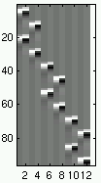
With a more flexible model
C₁ C₁ C₂ C₂ C₃ C₃
V A V A V A
Test C1 > C2 ?
Test C1 different from C2 ?
from
c = [ 1 1 -1 -1 0 0 0]
to
c = [ 1 0 1 0 -1 0 -1 0 0 0 0 0 0]
[ 0 1 0 1 0 -1 0 -1 0 0 0 0 0]
becomes an F test!
What if we use only:
c = [ 1 0 1 0 -1 0 -1 0 0 0 0 0 0]
OK only if the regressors coding for the delay are all equal

Slide 42
Toy example: take home ...
use F tests when
  Test for >0 and <0 effects
  Test for more than 2 levels in factorial designs
  Conditions are modelled with more than one regressor
Check post hoc

Slide 43
Thank you for your attention!
jbpoline@cea.fr
jbpoline@gmail.com

Slide 44
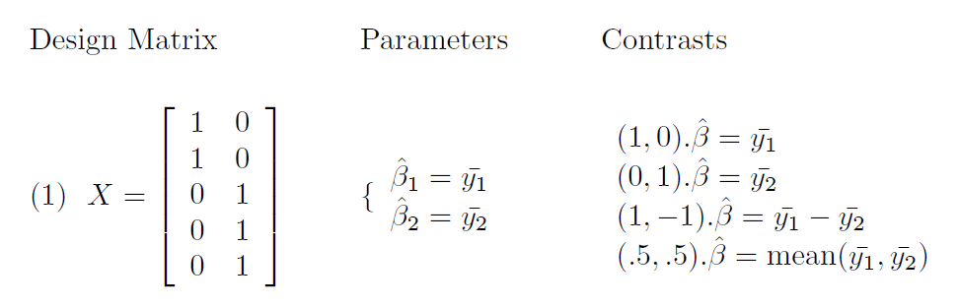
P_{x} Y = X β

Slide 45
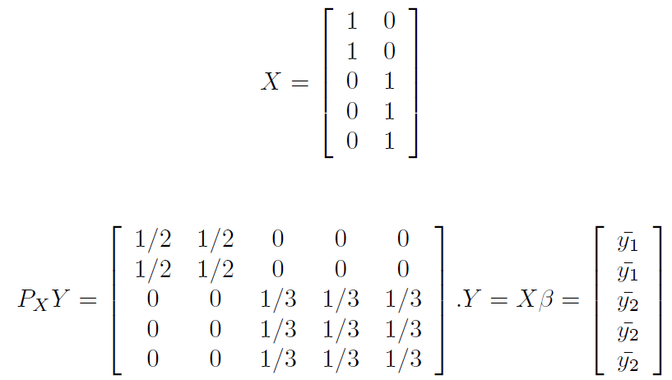
Projector onto X

Slide 46
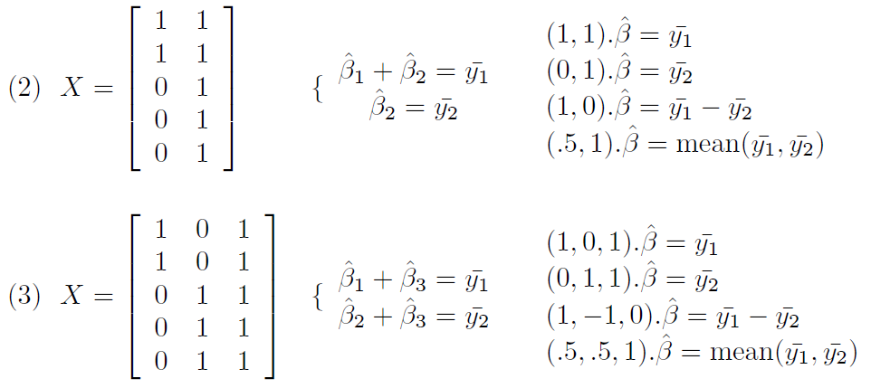

Slide 47
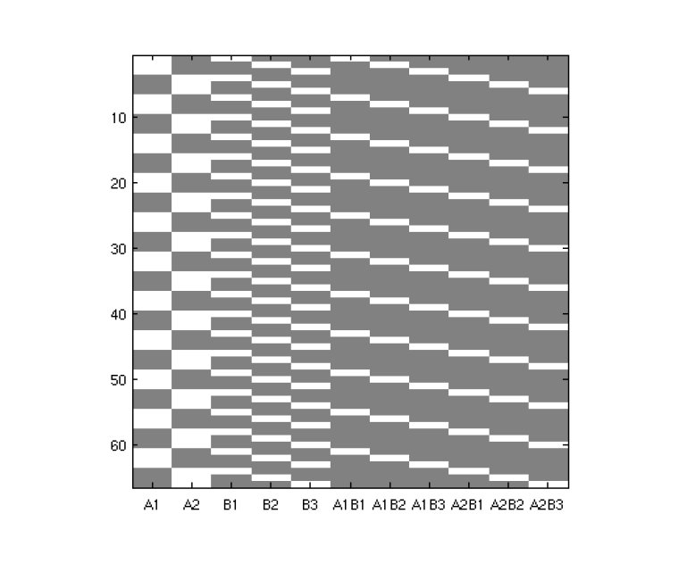

Slide 48
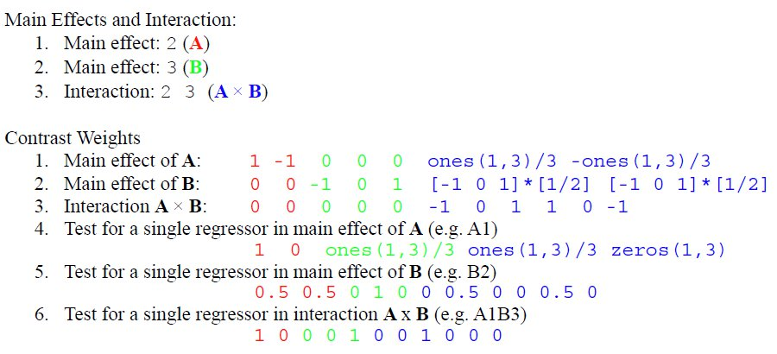

Slide 49
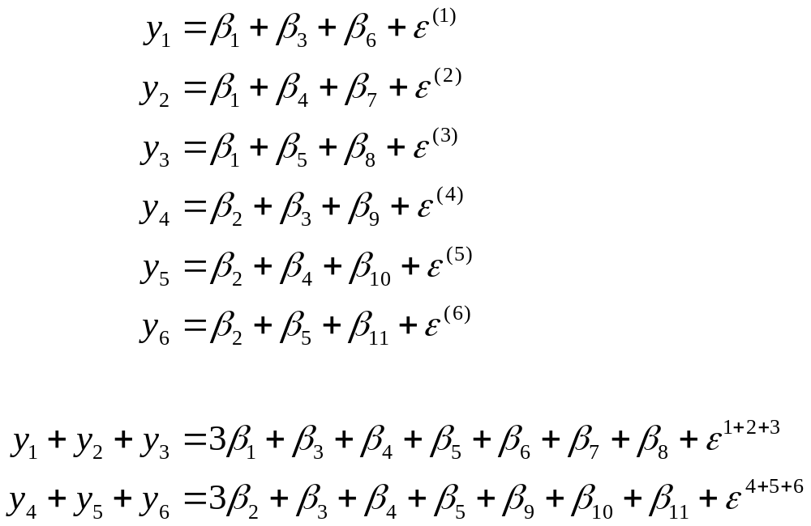

Slide 50
How is this computed ? (t-test)
Estimation [Y, X] [b, s]
Y = X β + ε ε ~ σ² N(0,I) (Y : at one position)
b = (X’X)⁺ X’Y (b: estimate of β) -> beta??? images
e = Y - Xb (e: estimate of ε)
s² = (e’e/(n - p)) (s: estimate of σ, n: time points, p: parameters)
-> 1 image ResMS
Test [b, s², c] [c’b, t]
Var(c’b) = s²c’(X’X)⁺c (compute for each contrast c, proportional to s²)
t = c’b / sqrt(s²c’(X’X)⁺c) c’b -> images spm_con???
compute the t images -> images spm_t???
under the null hypothesis H₀ : t ~ Student-t( df ) df = n-p

Slide 51
How is this computed ? (F-test)
additional
variance accounted for
by tested effects
Error variance
estimate
Estimation [Y, X] [b, s]
Y = X β + ε ε ~ N(0, σ² I)
Y = X₀ β₀ + ε₀ ε₀ ~ N(0, σ₀² I) X₀ : X Reduced
Test [b, s, c] [ess, F]
F ~ (s₀ - s) / s² -> image spm_ess???
-> image of F : spm_F???
under the null hypothesis : F ~ F(p - p0, n-p)

